Slide 1
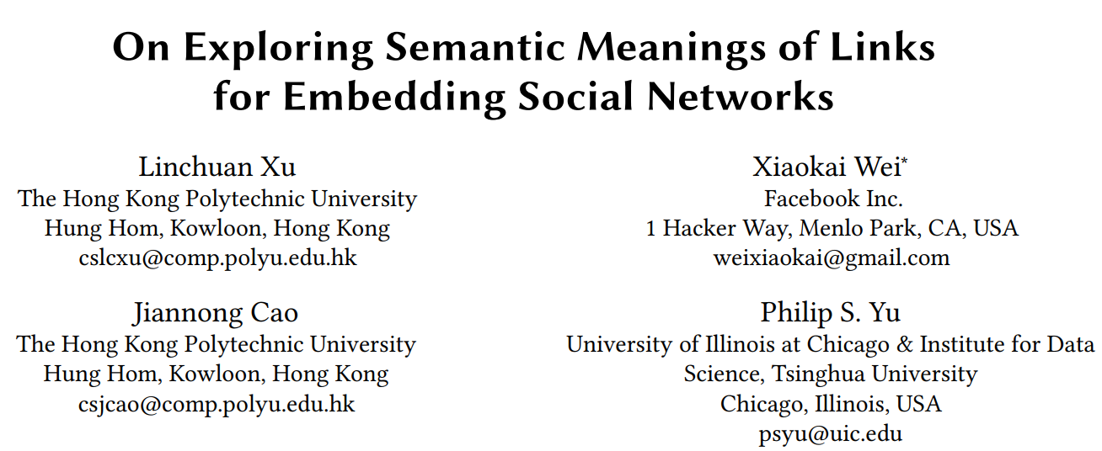
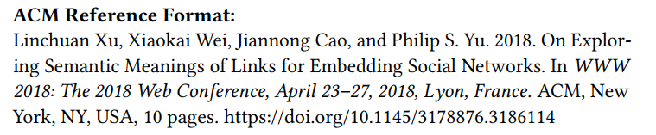

Slide 2
Motivation
diﬀerent links may have diﬀerent semantic meanings
two persons share a common university friend——education
two persons are fans of Star Wars——interest
Purpose: Categorize social links according to their semantic meanings
and learn node representations with semantic concepts.

Slide 3
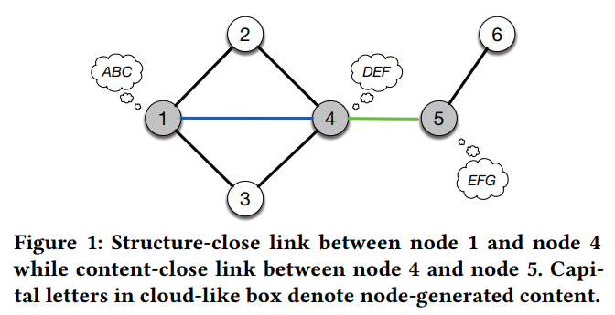
structure-close VS content-close

Slide 4
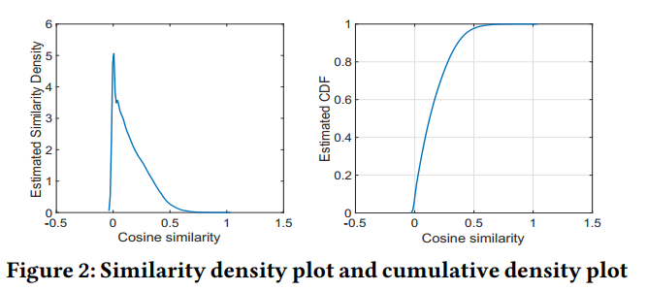
Learn a single representation for
each node?
validate
Content similarity in structure-close link

Slide 5
Learn two representations for each node
Content-close links resulting from sharing similar interests
Interest Representation
Structure-close links resulting from sharing neighbors
Identity representation

Slide 6
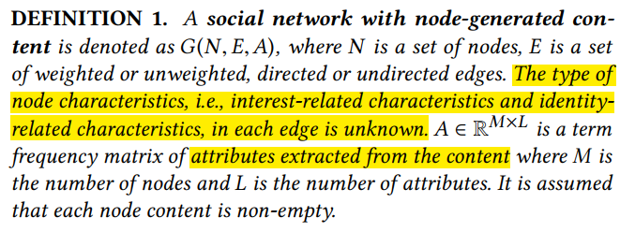
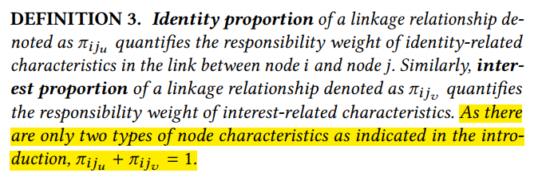
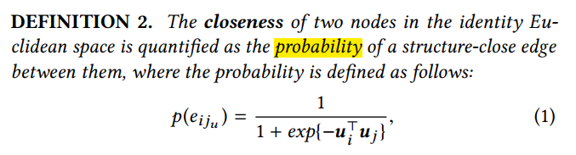
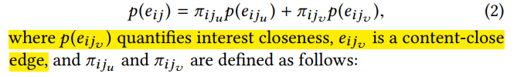

Slide 7
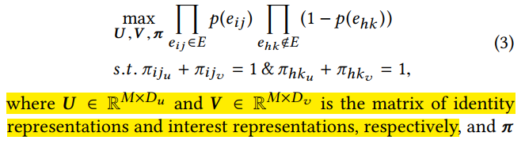
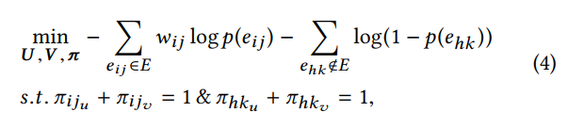
IIRL MODEL
maximum likelihood estimation
taking negative natural logarithm

Slide 8
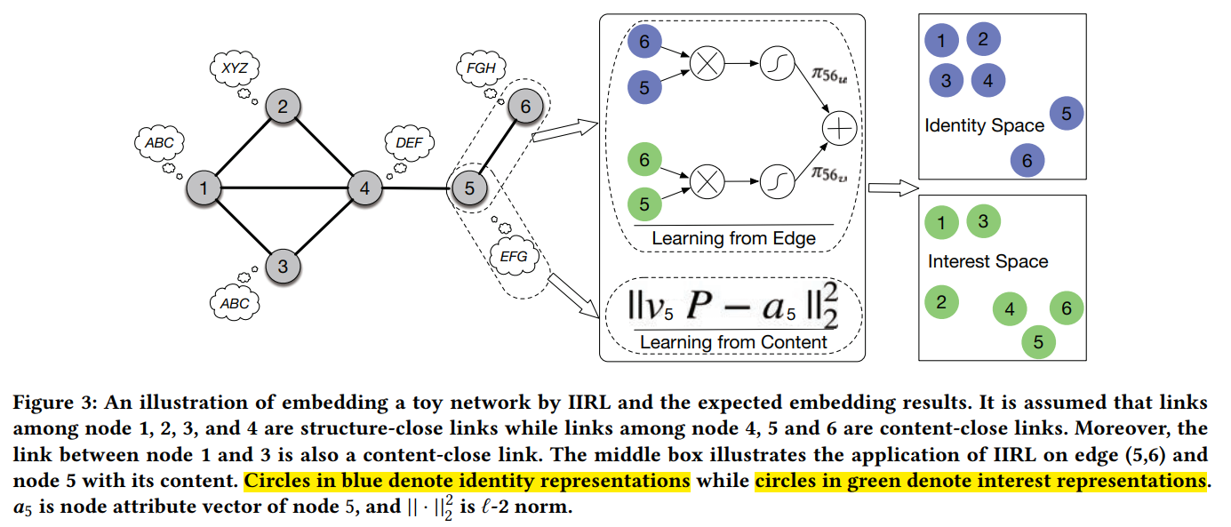

the user interests should be well represented by the interest representation V through the projection matrix P

Slide 9
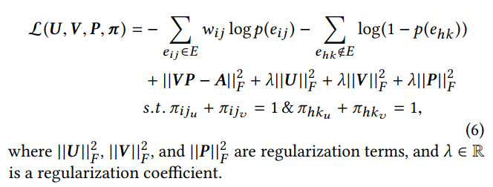
Loss function

Slide 10
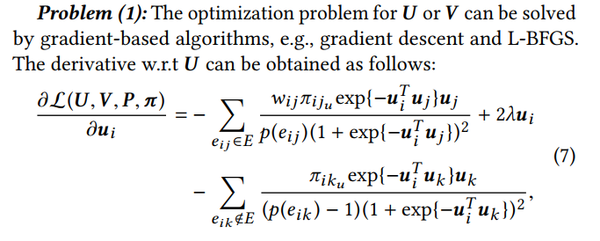
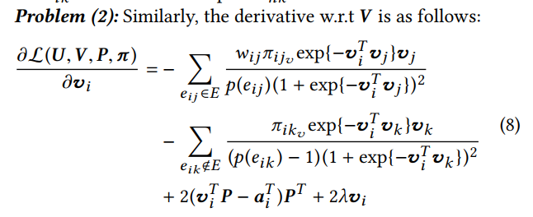
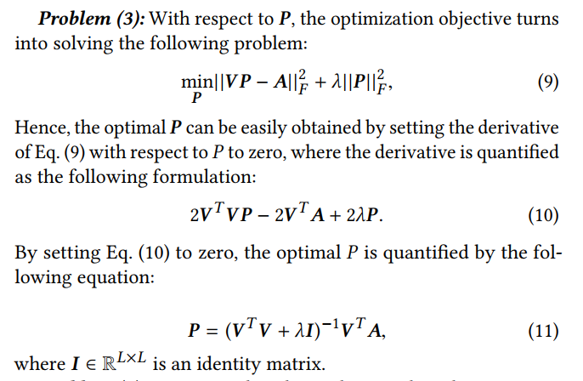
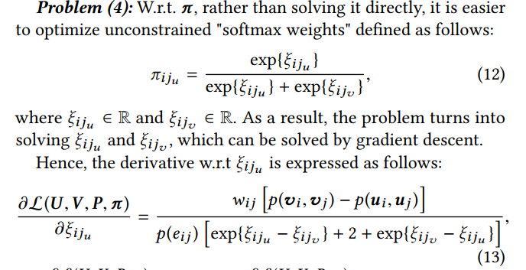
OPTIMIZATION ALGORITHM

Slide 11
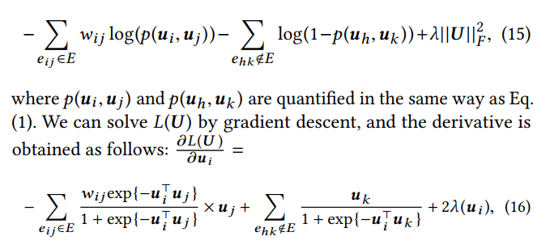
Pre-training

Slide 12
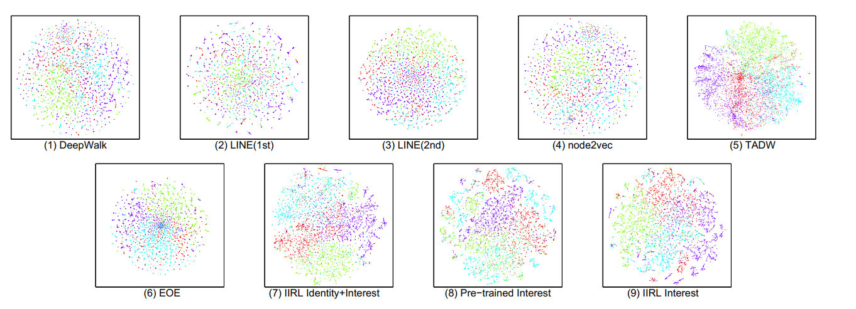
Experiment

Slide 13
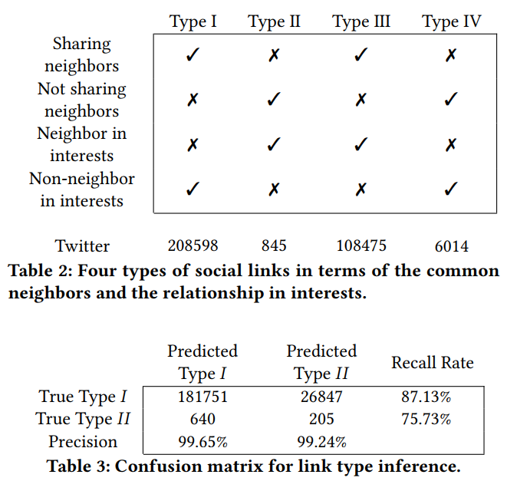
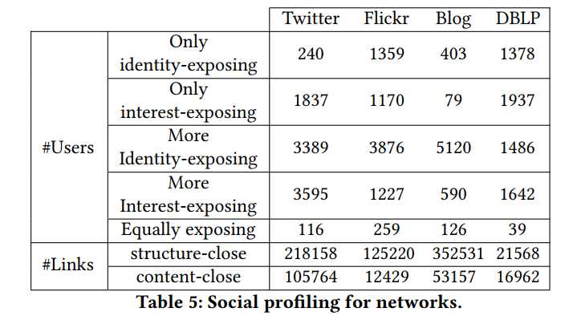
Link Type Inference
Social Profiling

Slide 14
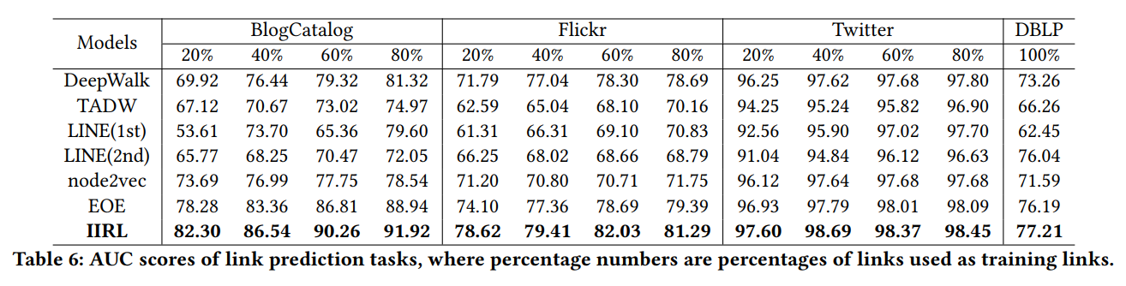
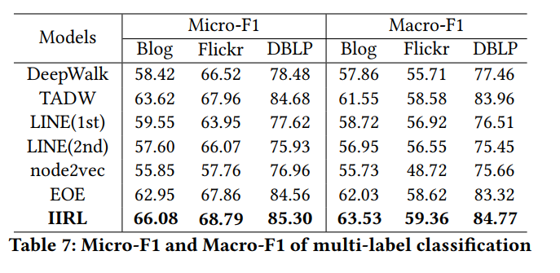
Link prediction
Multi-label classification

